Slide 1
Using AI Tools in POWER-BI for
Financial Analysis & Quick Insights
Presentation By
CA Gayathri S Praveen

Slide 2
Introducing Microsoft Power BI
Power BI is a cloud-based business analytics service that enables:
Fast and easy access to data
A live 360º view of the business
Data discovery and exploration
Insights from any device
Collaboration across the organization
Anyone to visualize and analyze data
Power BI
Notes:
Key message:
Power BI is a business analytics service. With Power BI you can now see all of your data through a single pane of glass. Live Power BI dashboards and reports show visualizations and KPIs from data residing both on-premises and in the cloud, providing a consolidated view across your business regardless of where your data lives.
Talking points:
This is Power BI in a nutshell and the overall benefits to your business. We will look at what this means for the IT Pro and the key benefits for IT on the next slide

Slide 3
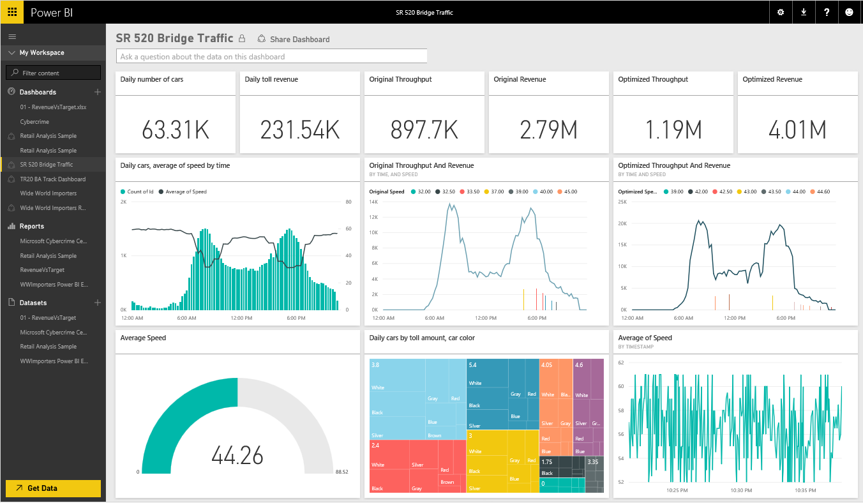

Slide 4
POWER-BI for Financial Analysis Quick Insights

Slide 5
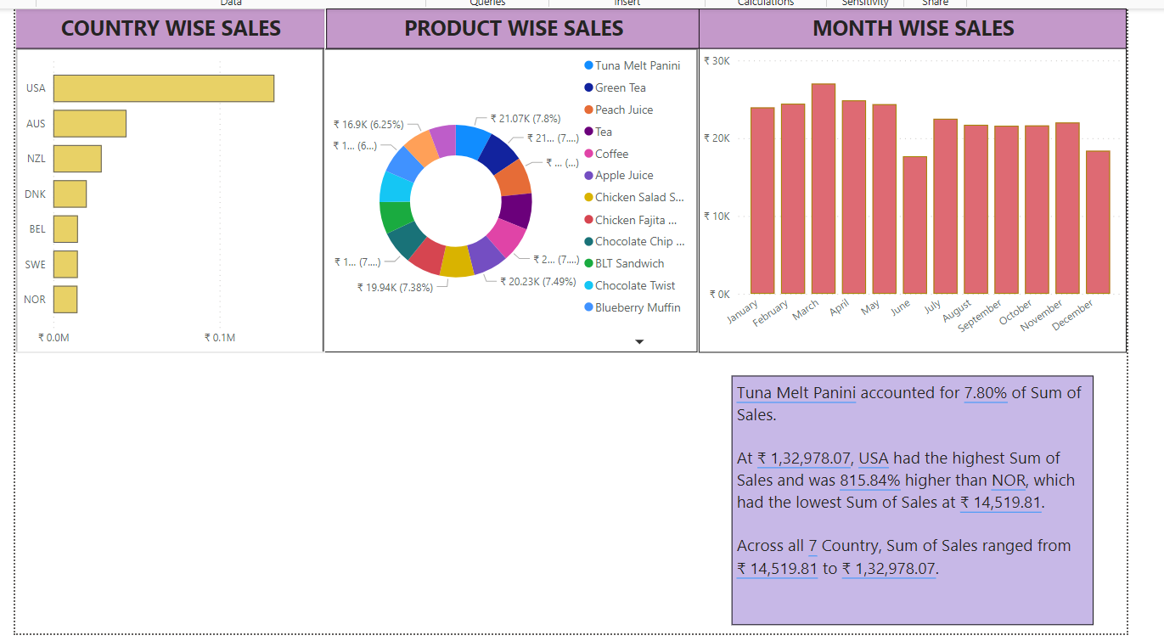

Slide 6
POWER-BI to answer your Questions based on data uploaded

Slide 7
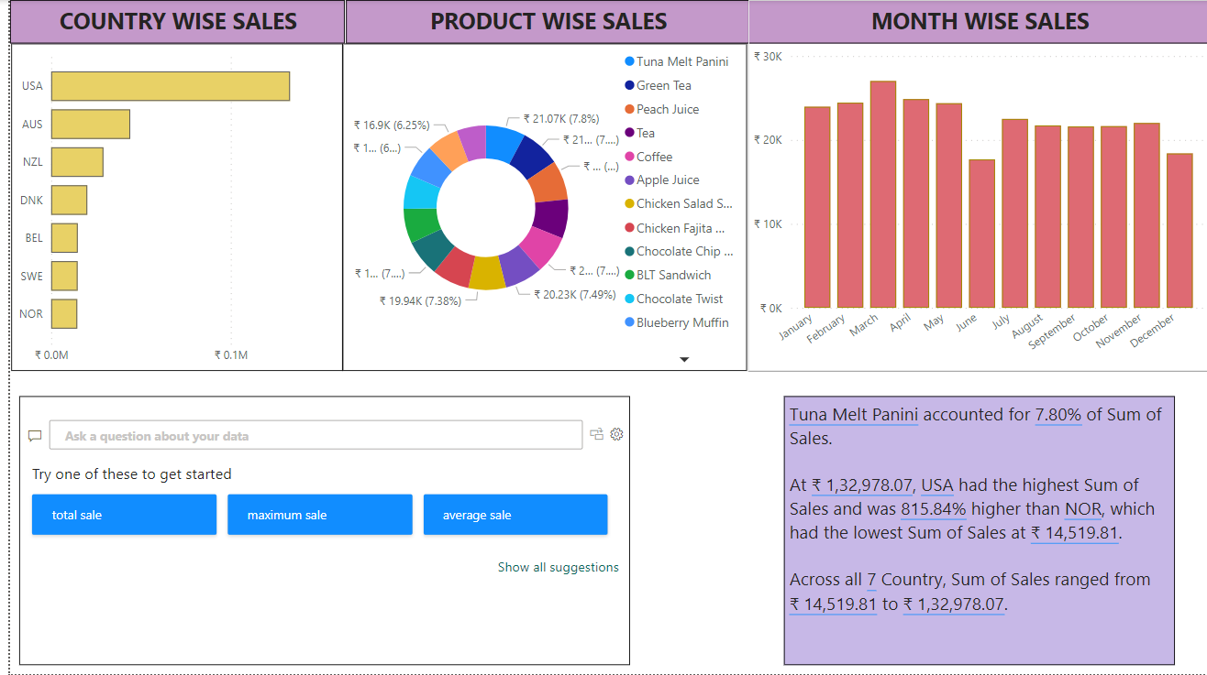

Slide 8
THANK YOU

