Slide 1
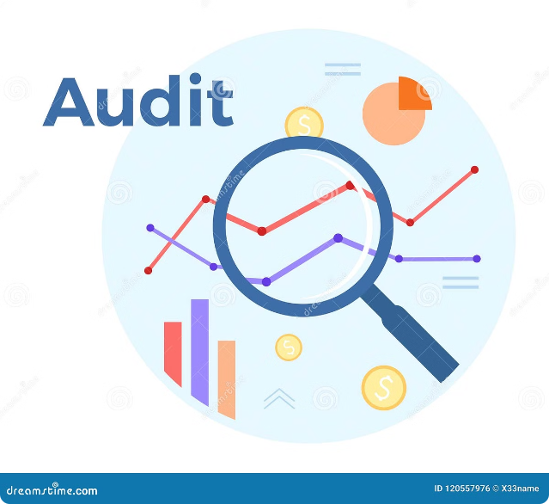
The Power of AI in Tax Audit
AI is revolutionizing tax audit by automating tasks, identifying risks, and uncovering patterns that humans miss.
by CA Sneha Agarwal

Slide 2
The Role of Machine Learning in Tax Audit
Machine learning algorithms play a crucial role in modern tax audits, enhancing efficiency, accuracy, and risk assessment.
By analyzing vast amounts of data, ML algorithms can uncover complex patterns and anomalies, streamlining the audit process.

Slide 3
Automated Data Extraction and Analysis
Faster & More Accurate
Enhanced Insights
AI can quickly extract data from various sources, such as invoices, receipts, and tax forms, saving time and reducing errors.
AI algorithms analyze data to identify trends, anomalies, and potential inconsistencies, providing valuable insights for auditors.

Slide 4
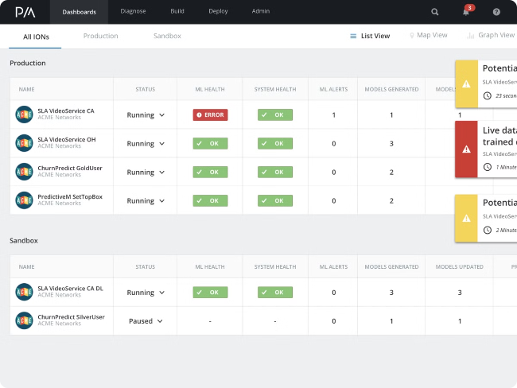
Anomaly Detection and Risk Identification
Suspicious Transactions
AI can flag unusual spending patterns, large transactions, or inconsistencies in financial data that may indicate fraud or tax evasion.
Tax Compliance Risk
AI models analyze data to assess the likelihood of tax compliance issues, helping auditors focus their efforts on high-risk areas.

Slide 5
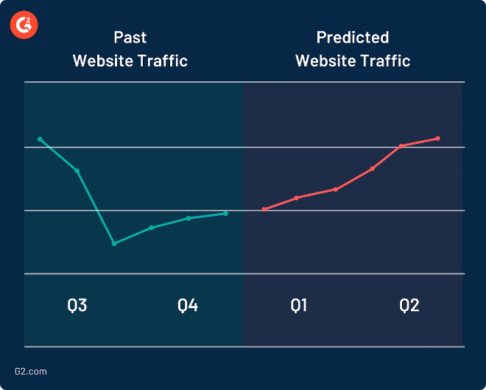
Predictive Modeling for Audit Selection
1
Data Gathering
AI gathers data from past audits, tax filings, and other sources to identify key factors influencing audit selection.
2
Model Training
AI models are trained on this data to predict the likelihood of audit selection for different taxpayers and situations.
3
Audit Selection
The AI-powered model provides insights to audit teams, helping them prioritize audits based on risk levels and potential impact.

Slide 6
Natural Language Processing for Tax Form Review
Automatic Form Review
AI can quickly scan tax forms, identifying inconsistencies, errors, and potential red flags.
Understanding Complex Language
AI can understand natural language, interpreting legal jargon and complex tax regulations, ensuring accurate form interpretation.
Fraud Detection
NLP algorithms can detect patterns and anomalies in language used on tax forms, alerting auditors to potential fraud.

Slide 7
Robotic Process Automation for Compliance Tasks
1
Increased Efficiency
2
Reduced Errors
3
Cost Savings
RPA automates repetitive tasks such as data entry, form processing, and document retrieval, freeing up auditors for more complex analysis.
RPA eliminates human error in data processing, ensuring accurate and consistent results for tax compliance tasks.
RPA reduces the time and resources required for manual tasks, leading to significant cost savings for tax audit operations.

Slide 8
AI-Assisted Tax Planning and Strategy
Tax Optimization
Predictive Analysis
Personalized Advice
AI can analyze various tax scenarios, recommending strategies to minimize tax liabilities and maximize tax savings for taxpayers.
AI can forecast future tax liabilities based on historical data, helping taxpayers prepare for potential tax changes and adjust their strategies accordingly.
AI can provide personalized tax advice based on individual circumstances, ensuring optimal tax planning outcomes.

Slide 9
Fraud Detection and Prevention
Unusual Spending Patterns
AI can identify anomalies in spending patterns, such as sudden large purchases or frequent transactions with suspicious entities.
Identity Theft
AI can detect fraudulent tax filings using identity theft by identifying inconsistencies in taxpayer information and comparing it to past filings.
Tax Evasion Schemes
AI can analyze data for patterns and indicators of tax evasion schemes, such as hidden income, offshore accounts, or mischaracterized expenses.

Slide 10
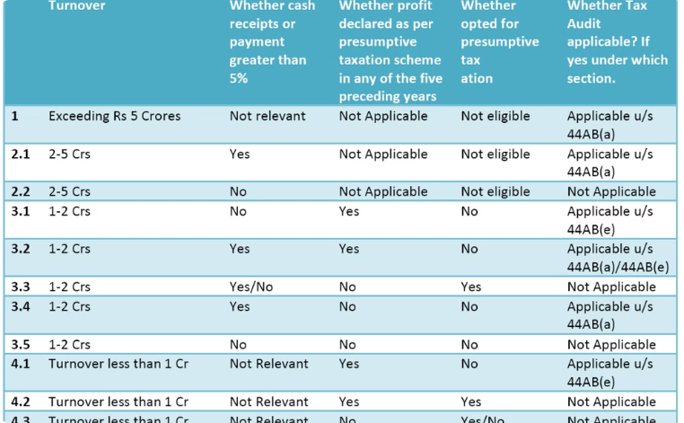
Continuous Monitoring and Audit Optimization
Real-Time Insights
Optimized Audit Planning
AI can provide real-time insights into tax compliance trends, allowing auditors to identify potential issues before they escalate.
AI can analyze audit data to identify patterns and trends, helping auditors optimize audit planning and resource allocation.

Slide 11
The Future of AI in Tax Audit: Challenges and Opportunities
AI is poised to transform tax audit, but challenges remain. Ethical considerations, data privacy, and the need for human oversight are crucial areas to address as AI continues to evolve.

