Slide 1
Depreciation
AI-Driven Python solution

Slide 2
Depreciation -AI-Driven Python solution
Common Mis-statements in Audit?
Incorrect Useful Life
Incorrect Residual Value Estimates
Improper Categorization of Assets
Incorrect Application of Depreciation Methods
Inaccurate Initial Asset Cost Recording
Failure to Account for Asset Disposals
Inconsistent Application of Policies
Timing Differences and Deferred Tax Calculation Errors

Slide 3
Depreciation -AI-Driven Python solution
What’s covered?
To demonstrate how AI can be used to detect and correct errors in depreciation calculations, ensuring accurate financial statements in
Calculation of Depreciation as per Schedule II of Companies Act
Calculation of Depreciation as per Income Tax Act
Calculation of Deferred Tax due to timing difference of depreciation

Slide 4
Depreciation -AI-Driven Python solution
Pre-requisites and approach
Install Python: Make sure you have Python installed on your system. You can download it from python.org.
Save the Script: Save the script in a text file with a ‘.py’ extension.
(in our case ‘depreciation_calculation.py’)
Open Command Prompt:
Press ‘Win + R’, type ‘cmd’, press ‘Enter’.
Navigate to the Script Location:
Use the ‘cd’ command to change the directory to where your script is saved.
Eg: >cd "Python\Depreciation Audit"

Slide 5
Depreciation -AI-Driven Python solution
Communication with AI
Use any AI like Chat GPT/Claude/Gemini/Copilot and specify the requirements:
Ex:
My requirement is to identify any mis-statement in case of incorrect useful life of Asset.
Hence, I am uploading the files of “Depreciation charts containing Assets details with Useful life” as per Both Companies Act and Income Tax Act.

Slide 6
Depreciation -AI-Driven Python solution
Communication with AI
In addition to rates of depreciation, if have further given the following prompt to AI as below:
My Asset register contains the following columns for I need to arrive at Depreciation value as per companies Act and Income Tax Act thereby arriving Deferred Tax calculations as per the rated provided:
Column:1 - Assets No. (Which means Asset Code) Column:2 - Asset_Type (Which means type of Asset) Column:3 - Capt- Dt- (Date of Capitalisation) Column:4 - Opening Acq. Val (Opening Cost) Column:5 - Acq. Val.- Addition (Additions) Column:6: Acq. Value - Retire (Deletions) Column:7 - Closing Acq. Val (Closing cost)

Slide 7
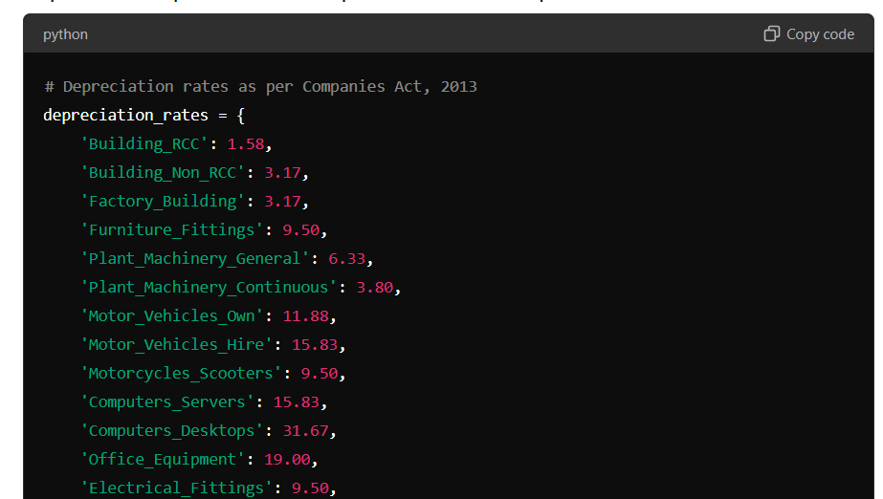
Depreciation -AI-Driven Python solution
Few Screenshots after the performing the above activity

Slide 8
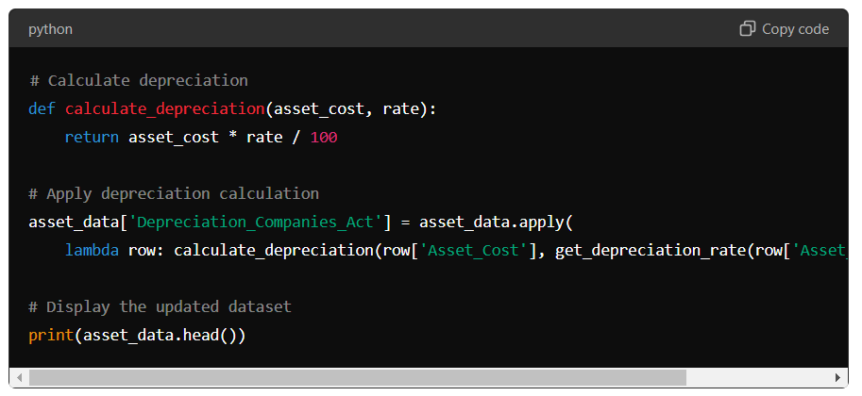
Depreciation -AI-Driven Python solution
Few Screenshots after the performing the above activity

Slide 9
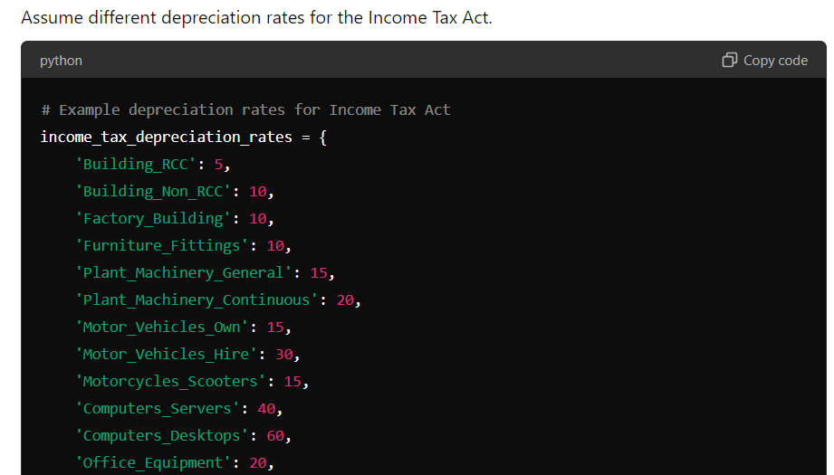
Depreciation -AI-Driven Python solution
Few Screenshots after the performing the above activity

Slide 10
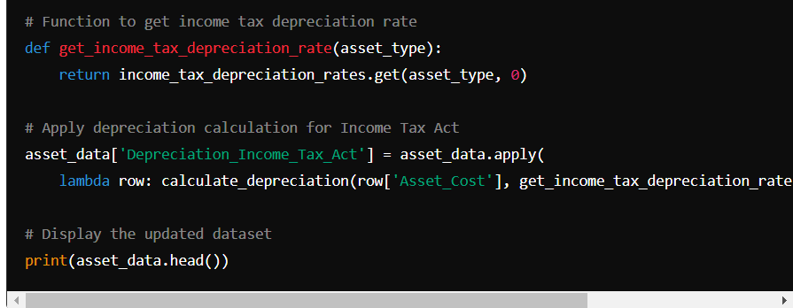
Depreciation -AI-Driven Python solution
Few Screenshots after the performing the above activity

Slide 11
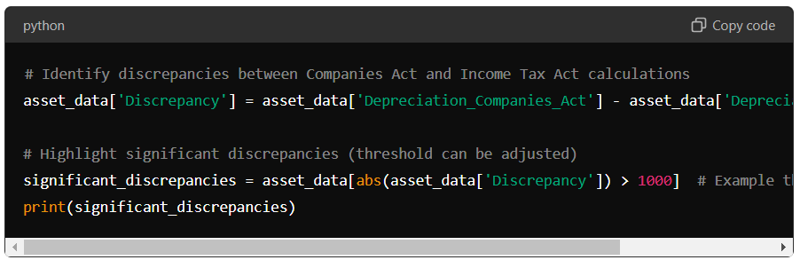
Depreciation -AI-Driven Python solution
Few Screenshots after the performing the above activity

Slide 12
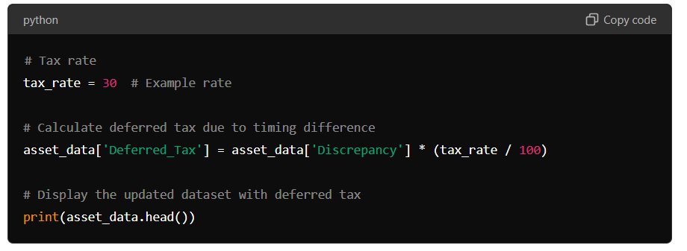
Depreciation -AI-Driven Python solution
Few Screenshots after the performing the above activity

Slide 13
Final Output
Finally save code into the file name as “depreciation_calculation.py”
Further, as save the asset details in csv format as “assets.csv” having the columns as defined above.
Open cmd and go to the path where the above files are saved.
Run the code in cmd and an output file is generated which contains the details of Depreciation as per both the acts and Deferred Tax.

Slide 14
Additional considerations
Verify and Install Required Dependencies
Install Essential Python Packages (PIPs)
Set Up the Code Environment in a directory
Provide into the code, the directory to save excel.

Slide 15
Thank you
- CA Ananth LN

