Slide 1
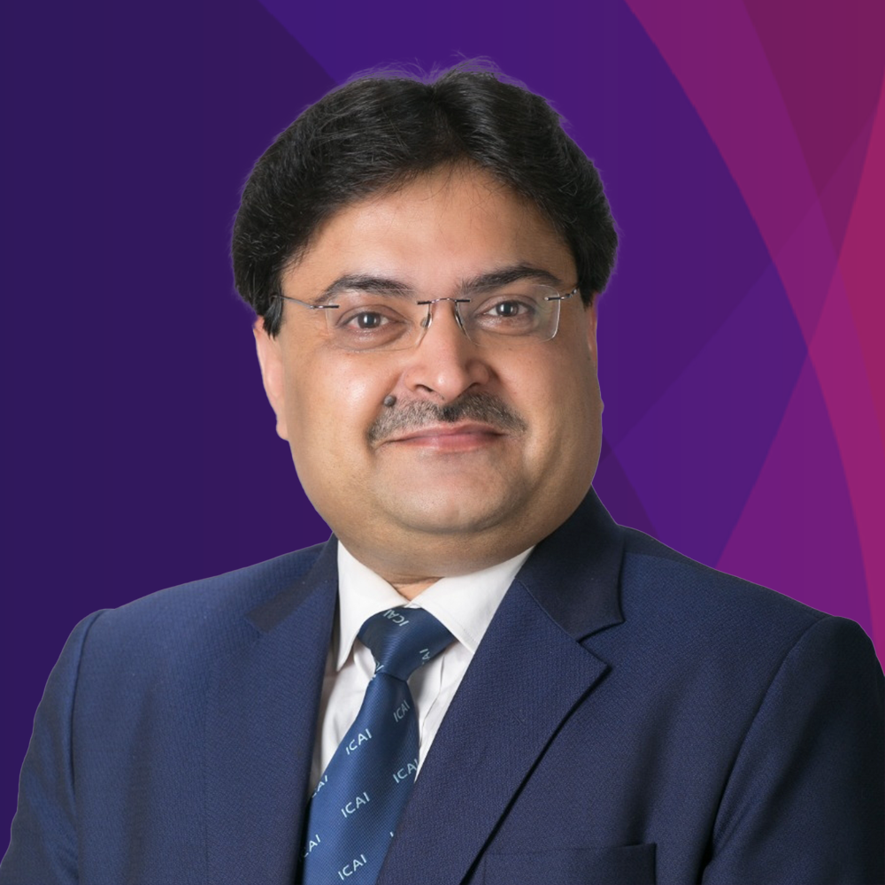
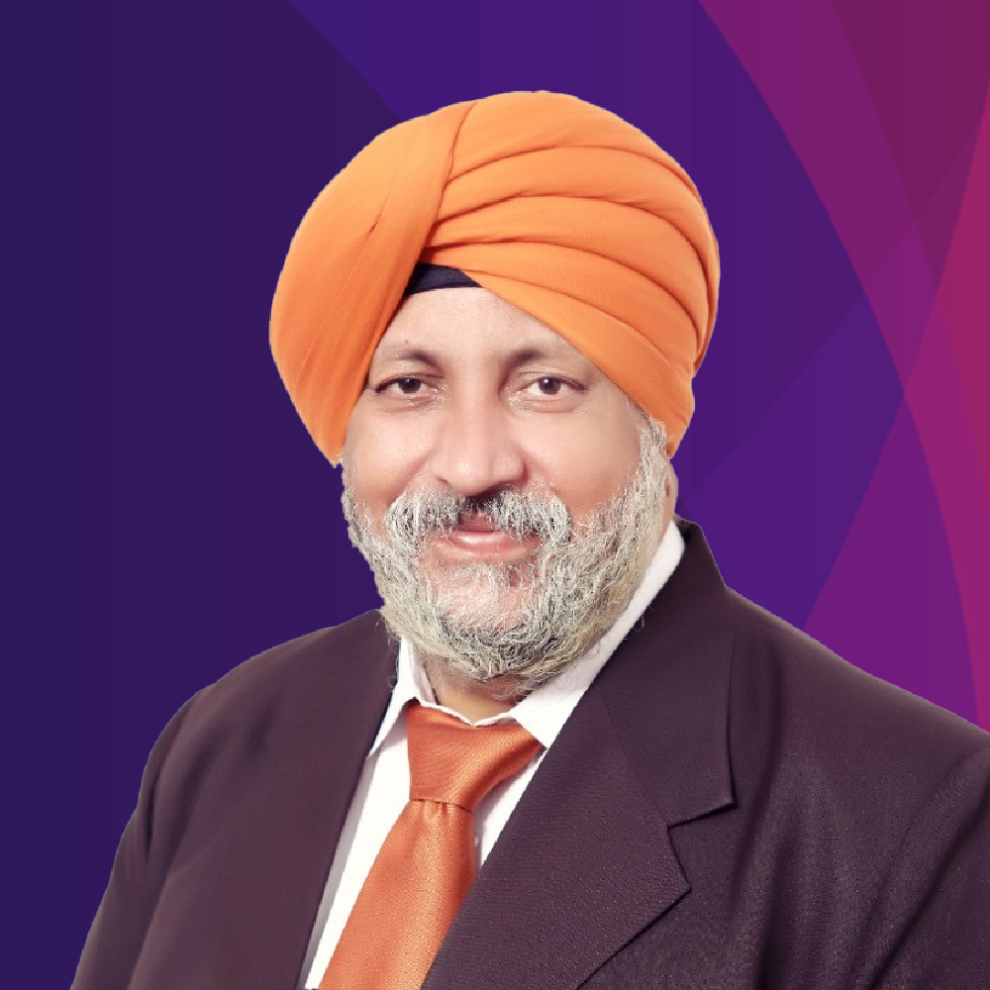
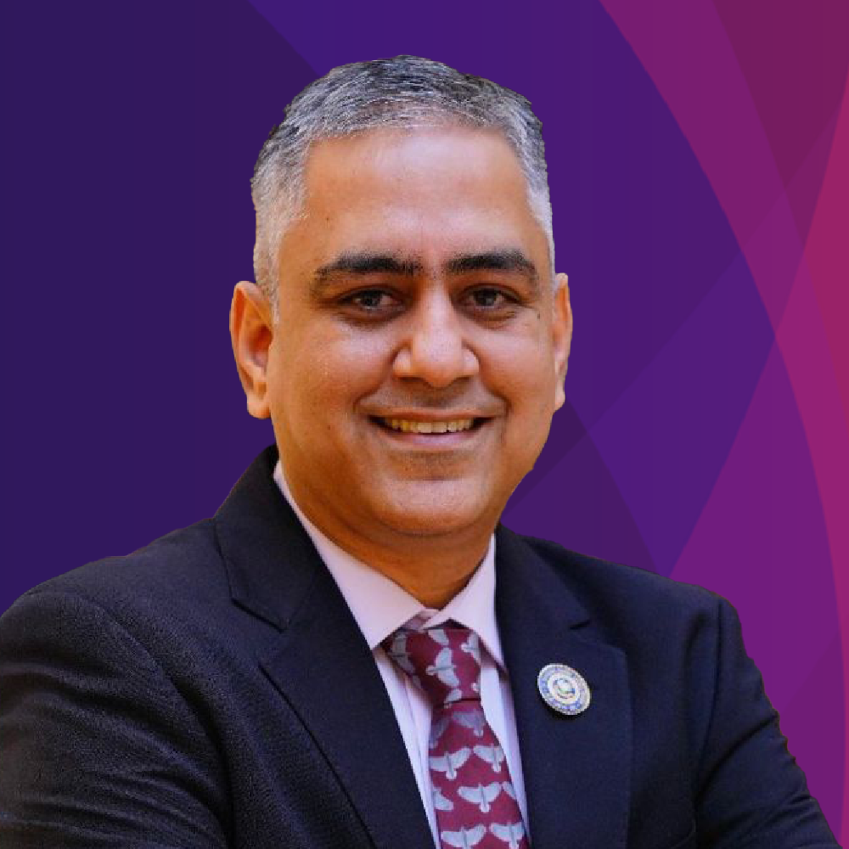
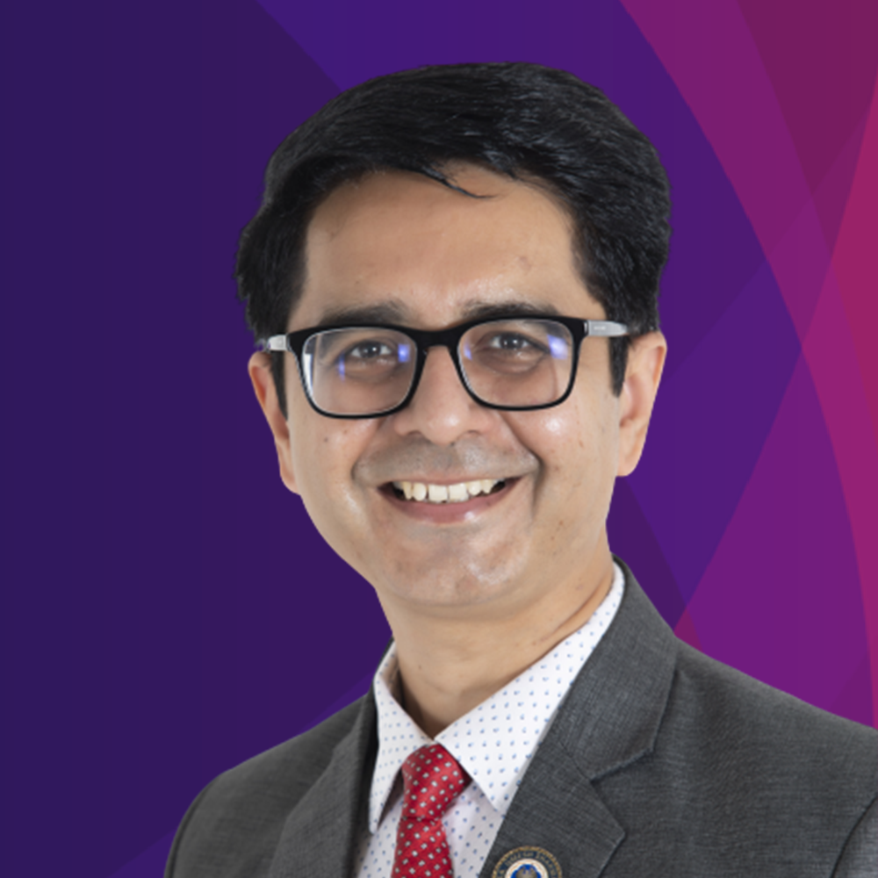
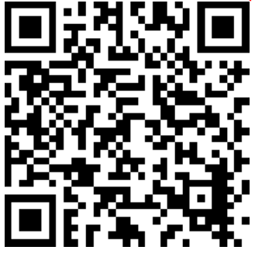
THE INSTITUTE OF CHARTERED ACCOUNTANTS OF INDIA
(Set up by an Act of Parliament)
AI in ICAI
AI in Accounting and Finance Forum 2024
CA. RANJEET KUMAR AGARWAL
President, ICAI
CA. CHARANJOT SINGH NANDA
Vice-President, ICAI
CA. DAYANIWAS SHARMA
Chairman, AI in ICAI
CA. UMESH SHARMA
Vice-Chairman, AI in ICAI
DATE – 22nd AUG 2024 TIME – 5PM – 7PM
AI HACKATHON 3 (SEASON 2) AI Use case in Accounting and Finance Forum
MODE: HYBRID VENUE : BANGLORE
AI Committee will invite Shortlisted Panelists to Present One Use Case in Webinar Scheduled on 22nd August 2024 (5 PM – 7 PM)
PANELISTS:
SCAN OR VISIT LINK BELOW: https://ai.icai.org/event_details.php?id=75
Panelist need to Register for AI Hackathon by 19th August 2024, 9 PM

