Slide 1
Input tax credit as per Books Vs GST 2A
Group Name B4G6
Batch - 4
CA. RAMA RAO VANKAYALA
M.No. 227633
CA. SANJAY M
M.No. 271866
CA. RAMSHARAN NANGUNURI
M.No. 246436
CA. RAMESH ATHASNIYA
M.No. 204976

Slide 2
RECONCILIATION OF GST INPUT CREDIT IN BOOKS WITH GST PORTAL
This presentation provides a comprehensive guide to reconciling GSTR 2A and books, highlighting the importance and benefits of using AI-powered tools for automation and accuracy.

Slide 3
Importance of Reconciliation
Reconciliation ensures accurate reporting and compliance with GST regulations.
It helps identify discrepancies and prevent penalties.
Financial Accuracy
Tax Compliance
Improved Decision Making
Aligns financial records with GST returns, ensuring accurate financial reporting.
Ensures adherence to GST regulations and avoids penalties and fines.
Provides insights into business performance and helps make informed financial decisions.

Slide 4
Challenges of Manual Reconciliation
Manual reconciliation is time-consuming, prone to errors, and requires significant manual effort. It can be challenging to handle large volumes of data.
Time Consuming
Error Prone
Inefficient Process
Manual processing of large datasets takes considerable time.
Human errors are inevitable, leading to inaccurate reconciliation and potential discrepancies.
Manual reconciliation is inefficient, requiring significant manual effort and repetitive tasks.

Slide 5
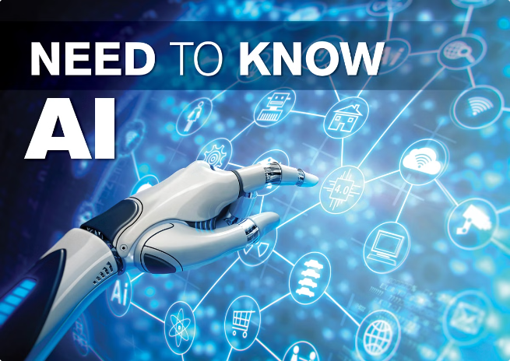
Leveraging tools for Automated Reconciliation
AI tools offer automated solutions for GSTR 2A and books reconciliation, eliminating manual effort and enhancing accuracy.
Data Extraction
AI extracts data from GSTR 2A and books automatically, reducing manual effort.
Data Matching
AI matches data points from both returns, identifying discrepancies and highlighting inconsistencies.
Automated Reconciliation
AI generates a reconciled report, highlighting discrepancies and suggesting corrective actions.

Slide 6
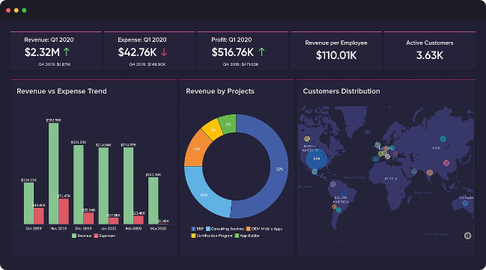
Key Features and Benefits
AI-powered reconciliation tools provide various features and benefits, simplifying the process and enhancing efficiency.
Enhanced Accuracy
Time Savings
AI algorithms minimize human error, leading to more accurate reconciliation.
Automated processes significantly reduce reconciliation time, freeing up resources.
Improved Efficiency
Real-time Insights
Streamlined workflows and automated tasks enhance overall efficiency and productivity.
AI provides real-time insights into discrepancies, enabling faster identification and resolution.

Slide 7
Step-by-Step Guide
AI-powered tools simplify the reconciliation process with a user-friendly interface and guided steps.
1
Data Upload
Upload GSTR 2A and GSTR 3B files to the AI platform.
2
Automated Reconciliation
AI automatically processes and matches data from both returns.
3
Discrepancy Report
AI generates a detailed report highlighting discrepancies and suggesting corrective actions.
4
Verification and Action
Review the report, verify discrepancies, and take necessary actions to resolve them.

Slide 8
Identifying and Resolving Discrepancies
AI-driven insights provide valuable information to help understand and resolve discrepancies effectively.
Discrepancy Type | AI Insight | Resolution
Missing Invoice | Identifies missing invoices based on matching criteria. | Upload missing invoice or correct the discrepancy.
Incorrect Amount | Highlights discrepancies in invoice amounts and tax calculations. | Verify and update the invoice details or reconcile the calculation.
Wrong GSTIN | Flags mismatches in GSTIN numbers between returns. | Correct the GSTIN and ensure accuracy in future invoices.

Slide 9
RPA Tools
Ginesys
GSTZen
Spectra
Winman
Computax
Cleartax
Finsights

Slide 10
Conclusion and Next Steps
AI-powered reconciliation tools streamline the process, improving accuracy and efficiency. Consider adopting AI for GSTR 2A and GSTR 3B reconciliation to optimize your GST compliance.
Regular Reconciliation
Employee Training
Feedback and Improvement
Implement regular reconciliation to ensure continuous compliance and avoid potential issues.
Train staff on using AI tools effectively to maximize their benefits and enhance reconciliation skills.
Provide feedback on AI performance and continually optimize processes for improved efficiency and accuracy.

Slide 11
Thank you
Batch 4
Group 6
RRRS

